Slide 1
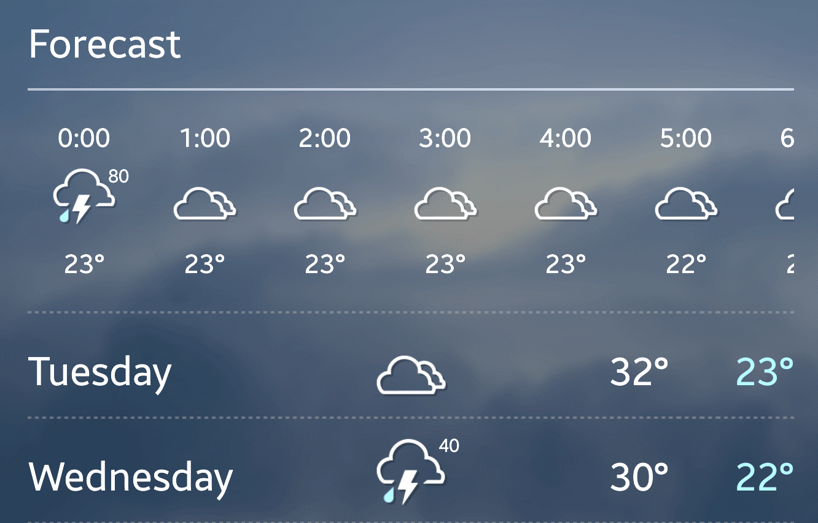
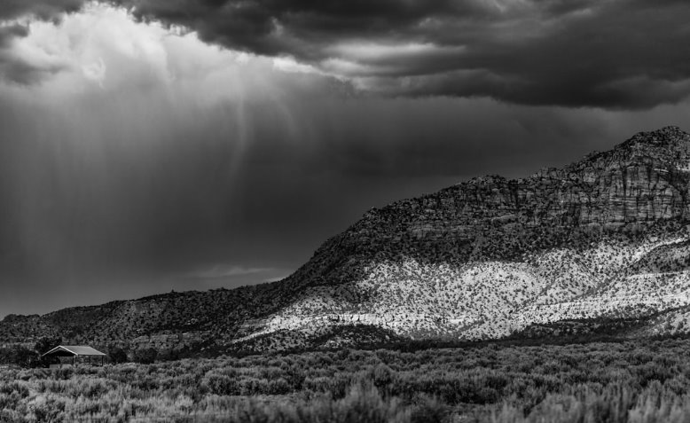
WEATHER FORECASTING USING MACHINE LEARNING (GROUP A)
PRESENTATION BY:
• DEVANSHI ADHIKARI
• ADVAIT MANISHKUMAR PANDIT
• AMRUTH RAJ MANCHIKANTI
JUNE 15, 2024

Slide 2
AGENDA
Project Management
Visualization
Coding Solution

Slide 3
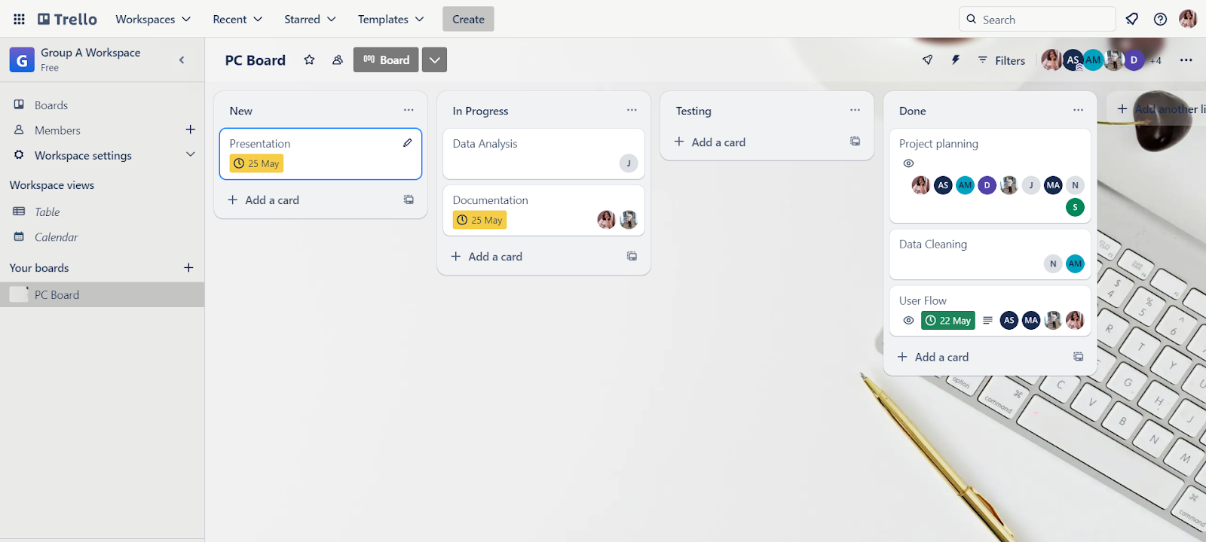
Project management
Tracking Roles + Accountability
Conflict Resolution
Project Divergence/Adaptations
Timetable Divergence
Platform Progress
Executing the Plan of Action
Meeting Documentation/Minutes
Proof of Discussion

Slide 4
PROJECT MANAGEMENT
Tracking Roles and Accountability
Tracking of roles is managed by project leader Aesha and assistant Devanshi.
Accountability:
Our team members are assigned to the following tasks:
Solution Flow
Data Management
Data Analysis
Documentation
Conflict Resolution:
Changed dataset for weather forecasting model due to lack of features in the initial dataset.

Slide 5
PROJECT MANAGEMENT
Project Divergence/Adaptations:
Adaptations included modifying the dataset and tools based on initial setbacks.
Timetable Divergence:
Initially planned timetable had to be adjusted due to data and communication issues. Updated timelines were communicated via Trello and Teams.
Platform Progress:
Used Trello for task tracking and GitHub for version control. Regular updates ensured progress tracking.
Executing the Plan of Action:
Each task was assigned and tracked using Trello. Regular check-ins ensured adherence to the plan.

Slide 6
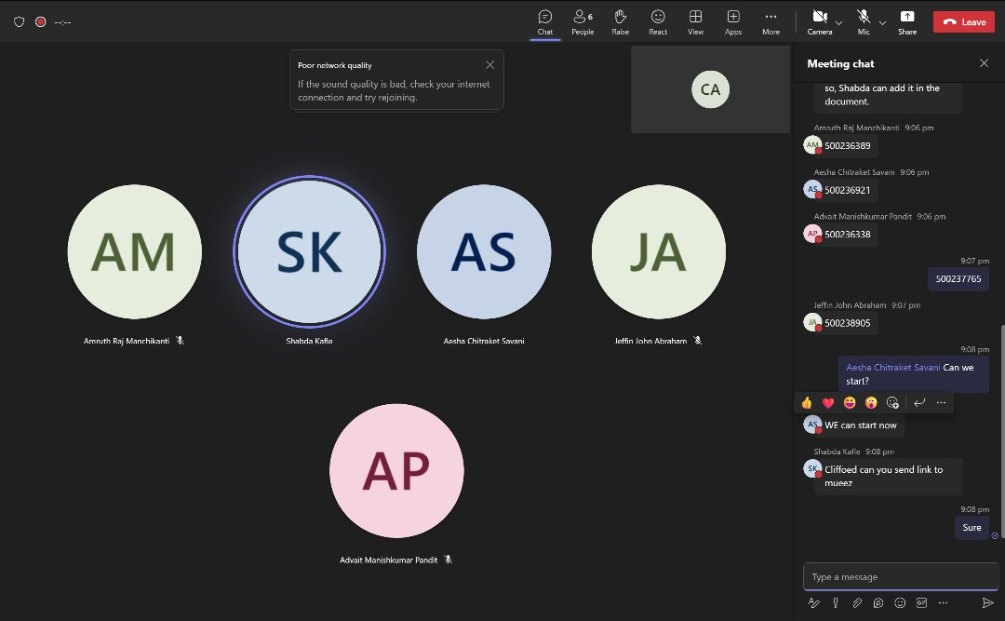
PROJECT MANAGEMENT
Meeting Documentation/Minutes:
All progress made are documented in the project report.
Proof of Discussion:
Available in the project documentation.

Slide 7
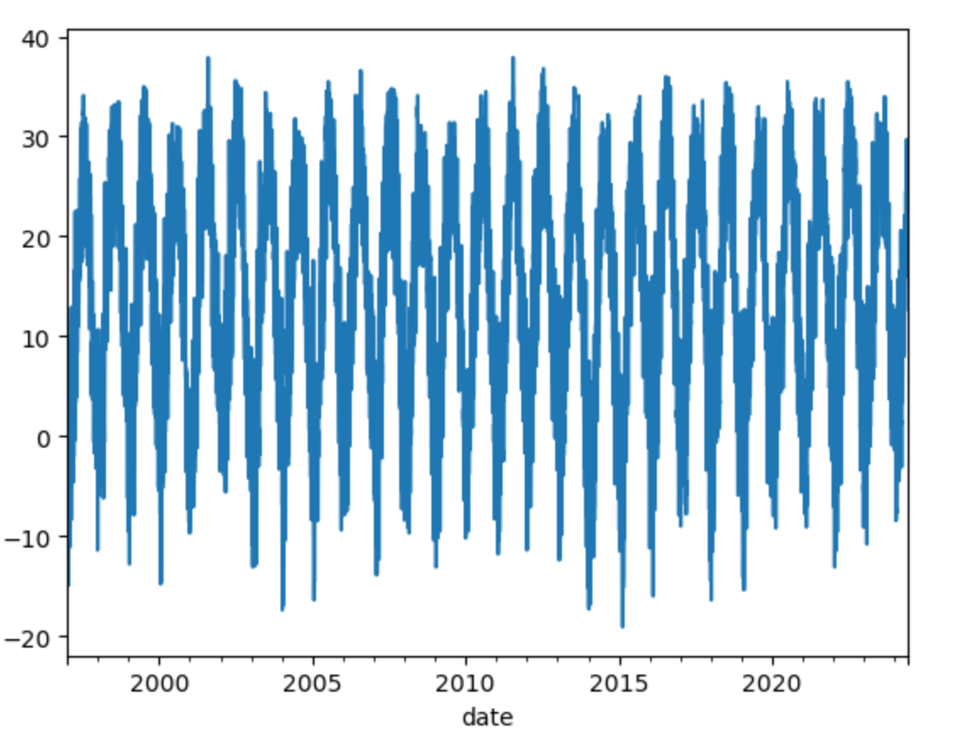
visualization
Choosing a Visual Type
Matching Type to Analysis
Addresses Multiple Features
Ease-of-Use, Intuitiveness
Balance of Detailedness/Complete
Interactivity
Integration on Platform

Slide 8
VISUALIZATION
Key Features captured in our visualization include:
Ease of Use and Intuitiveness:
We ensured that the charts were labeled clearly.
Balance of Detailedness:
We provided enough detail to be informative.
Interactivity:
We used interactive dashboard using Matplotlib.
Integration on Platform:
We have integrated into the final report and presentation.

Slide 9
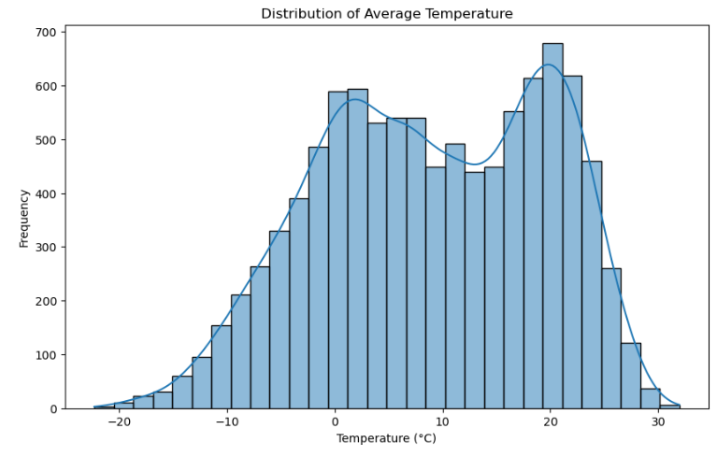
VISUALIZATION
Bar Chart for Data Comparison

Slide 10
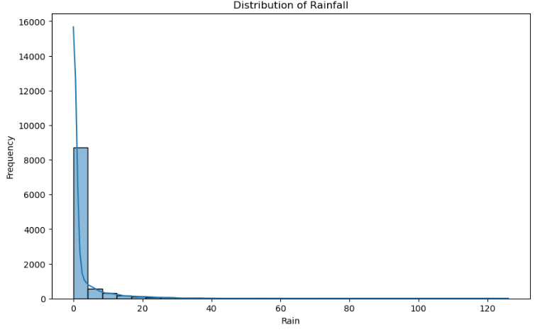
VISUALIZATION
Bar Chart for Data Comparison

Slide 11
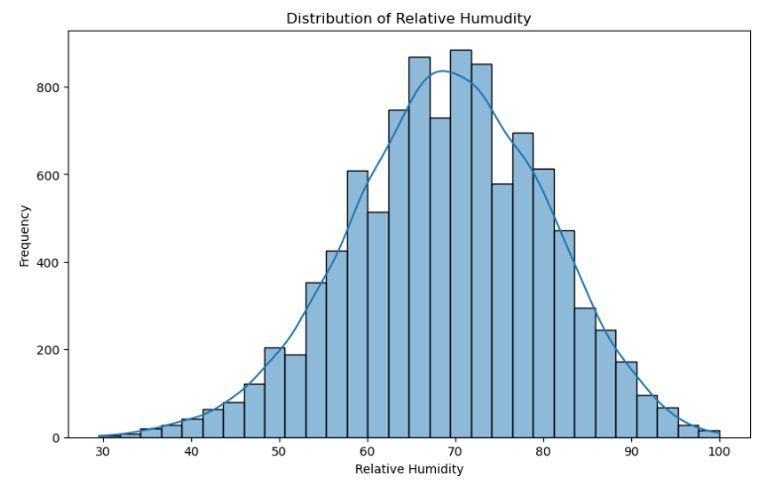
VISUALIZATION
Bar Chart for Data Comparison

Slide 12
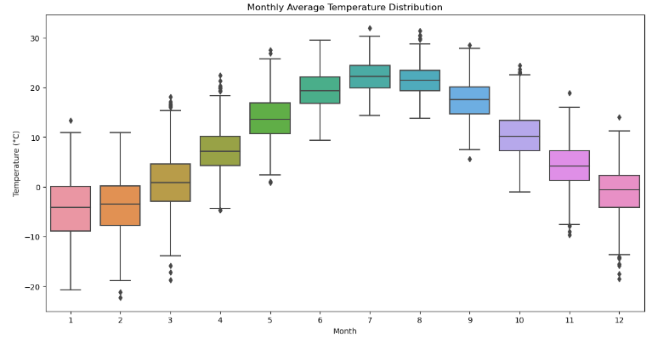
VISUALIZATION
Box Plot

Slide 13
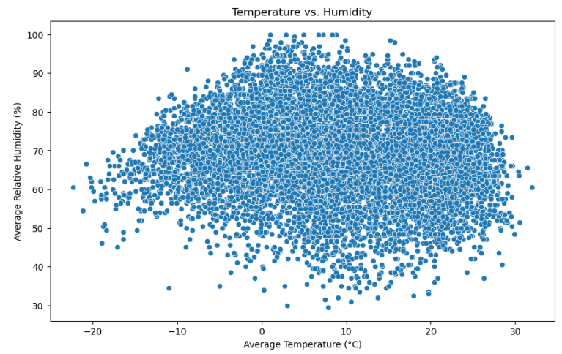
VISUALIZATION
Scatter Plot

Slide 14
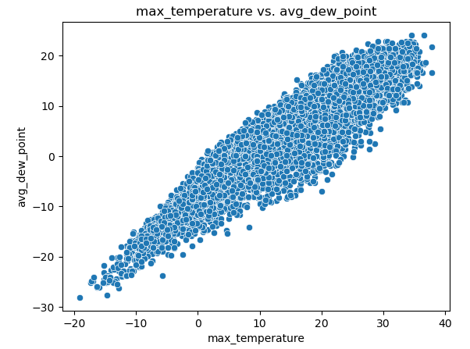
VISUALIZATION
Scatter Plot

Slide 15
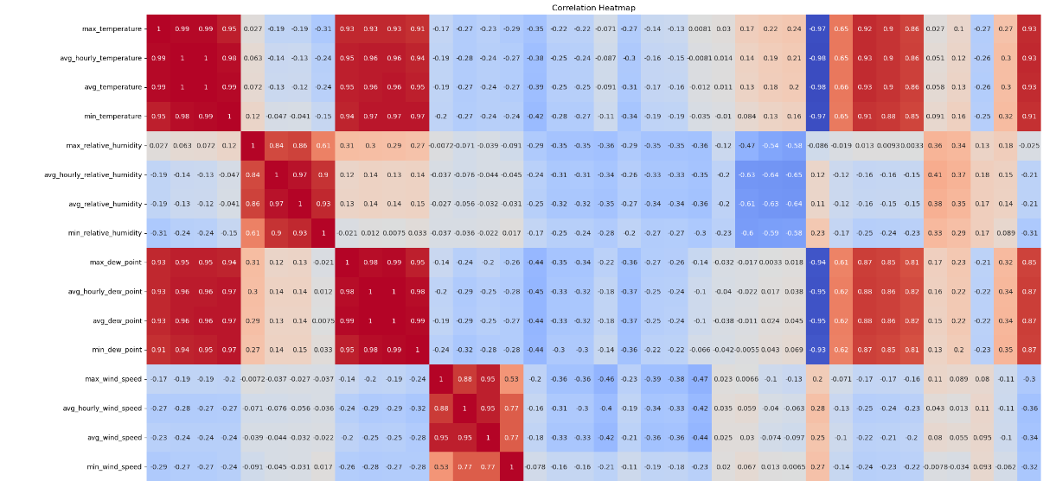
VISUALIZATION
Correlation Heatmap

Slide 16
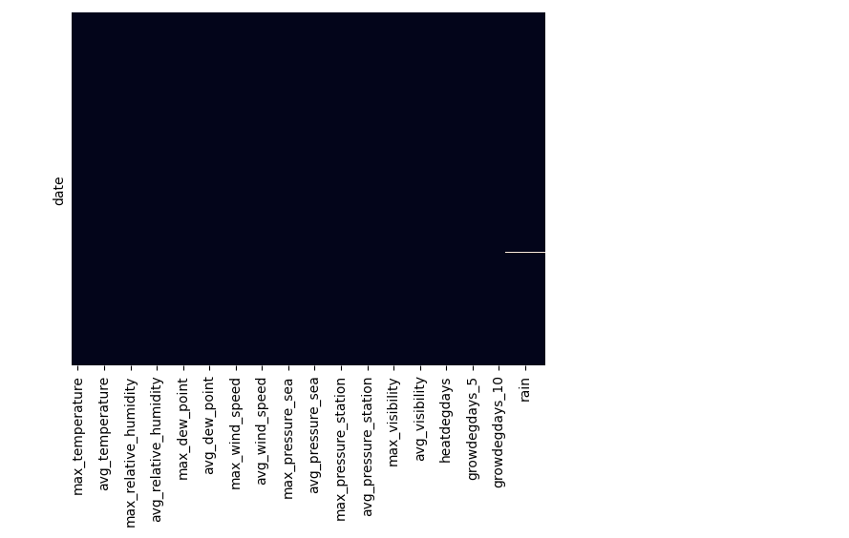
VISUALIZATION
Heatmap of Missing Data

Slide 17
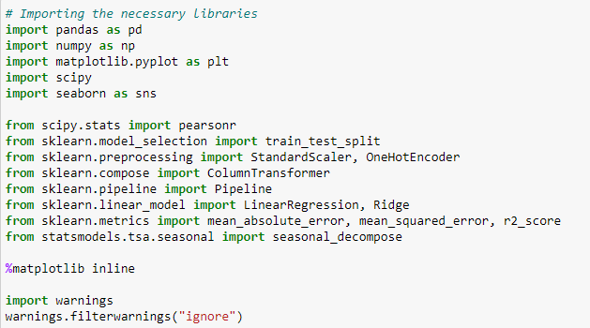
Coding solution
Code Commit/Versioning
Speed/Latency
Reliability
Testing
Easy-to-Adapt, Extendable, Scalable
Readable/Self-Explanatory Naming Conventions
Commenting
Collaboration

Slide 18
Coding solution
Code Commit/Versioning
Code commit or versioning managed on GitHub
Speed/Latency
We ensured low latency in the prediction.
Reliability
We ensured code reliability through group reviews and testing
Testing
We conducted tests to measure and optimize performance.

Slide 19
Coding solution
Easy-to-Adapt, Extendable, Scalable
We also ensured the code can be scaled for future needs.
Self-Explanatory Naming Conventions and Commenting
We used parameters to make the code flexible and reusable and added comments to ensure understanding and maintainability.
Collaboration
We organized meetings to foster collaboration between the teams responsible for EDA, Feature engineering and Modeling.

Slide 20
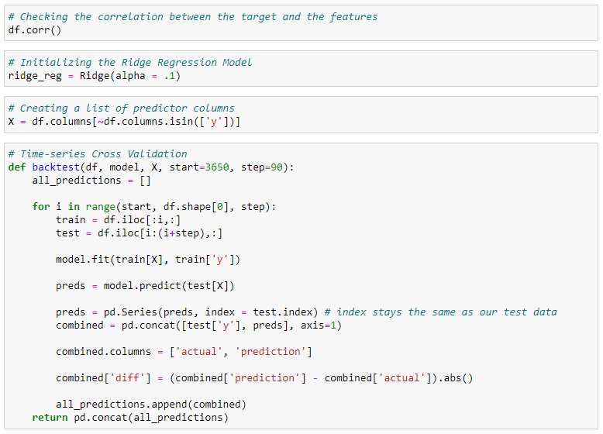
Coding solution
Sample Code

Slide 21
Summary
Recap of Project Management
Overview of Visualization Techniques
Summary of Coding Solution
Next Steps and Future Improvements

Slide 22
Q & A
We are excited to answer all your questions.

Slide 23
THANK YOU

